Slide 1
NLP - Section 8
LSTMs and Sequence2Sequence

Slide 2
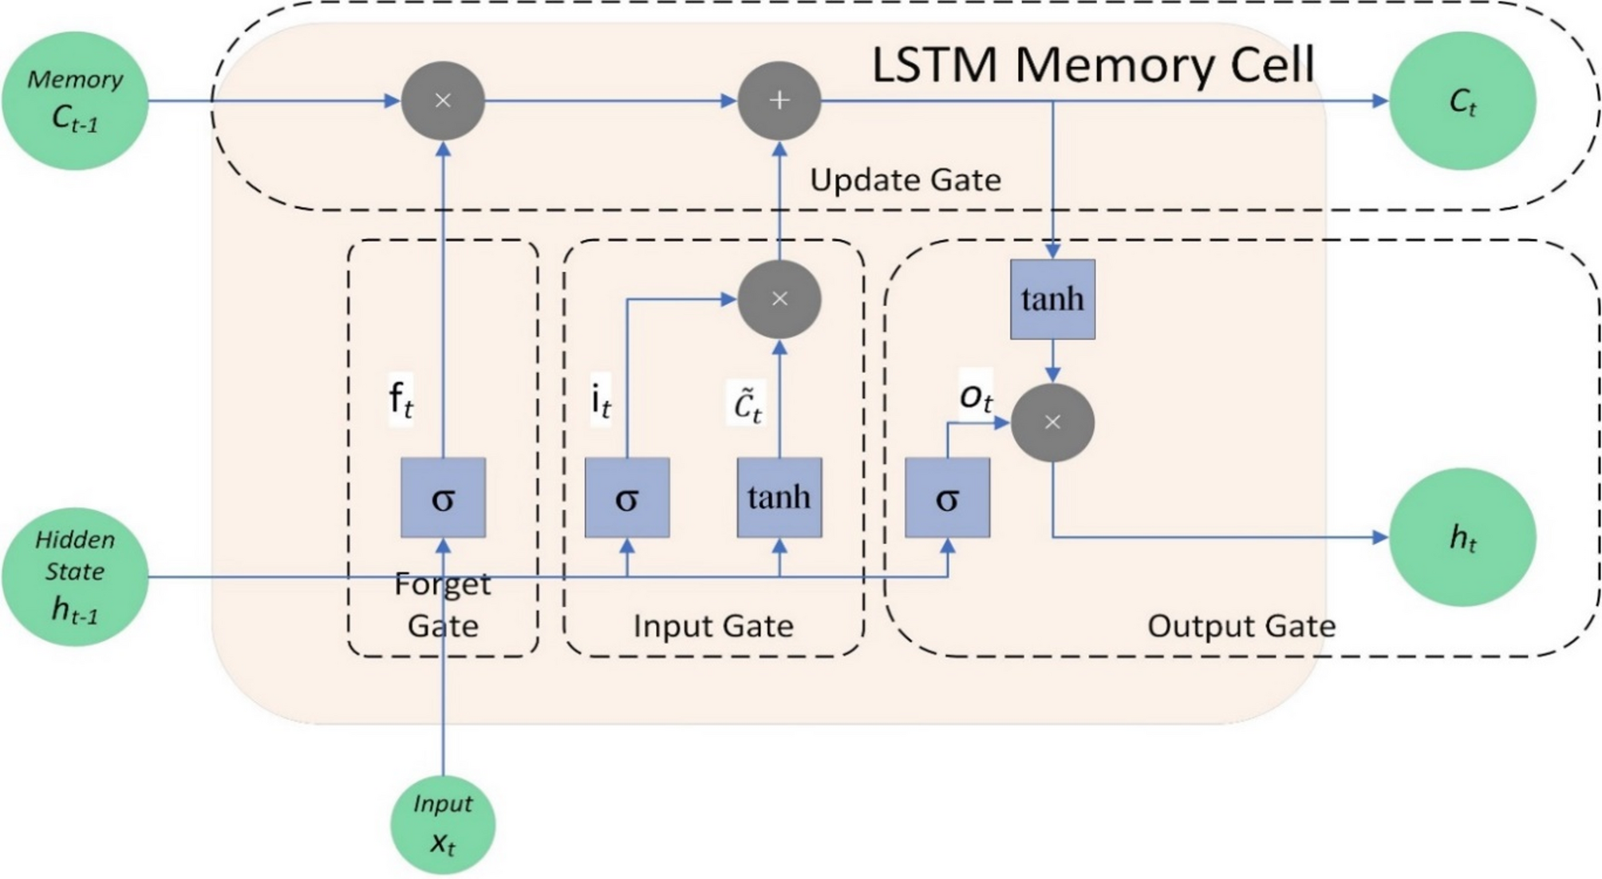
LSTMs
RNNs but with fancy math.
The main idea is conserving
long term memory and choosing what to remember
To do that we have 3 main gates and two outputs.
https://www.nature.com/articles/s41598-025-06809-w

Slide 3
Memory Cell
There are no weights in the memory cell. it can be modified by two operations only (sum and multiplication).
The lack of weights is to counterfeit the vanishing/exploding gradients problem
If the memory cell doesn’t contain weights, then it can be transferred directly to the last input without being diminished

Slide 4
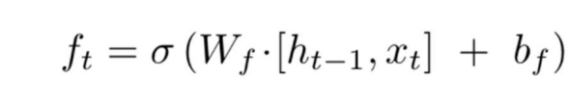
Forget Gate
Forget gate determines what to remember based on the input and the hidden state.
Since sigmoid returns values of mostly 0 or 1, if the value returned for the forget gate is 0, then the memory cell is wiped out.
If the value returned is 1, then the memory cell doesn’t change.

Slide 5
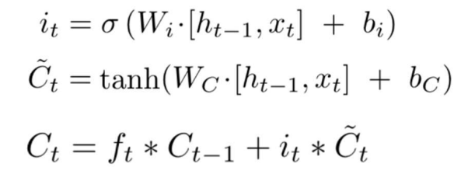
Input Gate
The input gate determines how much of the current input and the hidden state (short term memory) should be added to the memory cell (long term memory).
i_t represents the same “choosing” technique displayed in the forget gate.
~C_t represents the combination between the hidden state and the input.
C_t has now i_t*~C_t which represents the “choosing” by processing the combination through 0 or 1

Slide 6
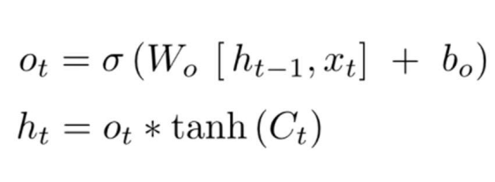
Output Gate
This gate outputs the hidden state which is also the short term memory for the next input.
It does the same “choosing” technique and outputs the hidden state based on what it selects from the memory cell after the activation function tanh

Slide 7
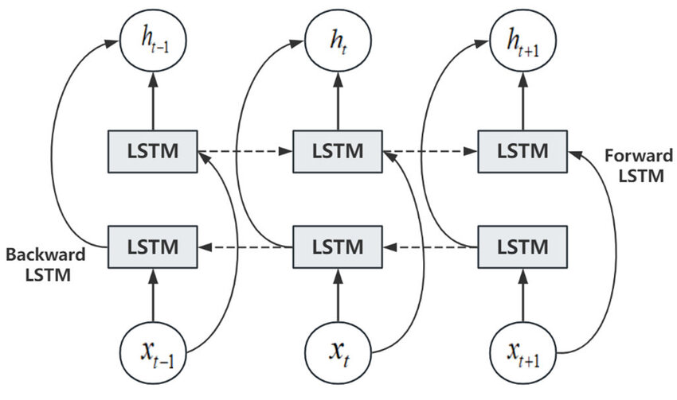
Bi-LSTM
Run the input forward and backward through the same LSTM and concatenate or sum the hidden states of both directions.
https://www.researchgate.net/figure/BiLSTM-model-structure-diagram_fig2_381367239

Slide 8
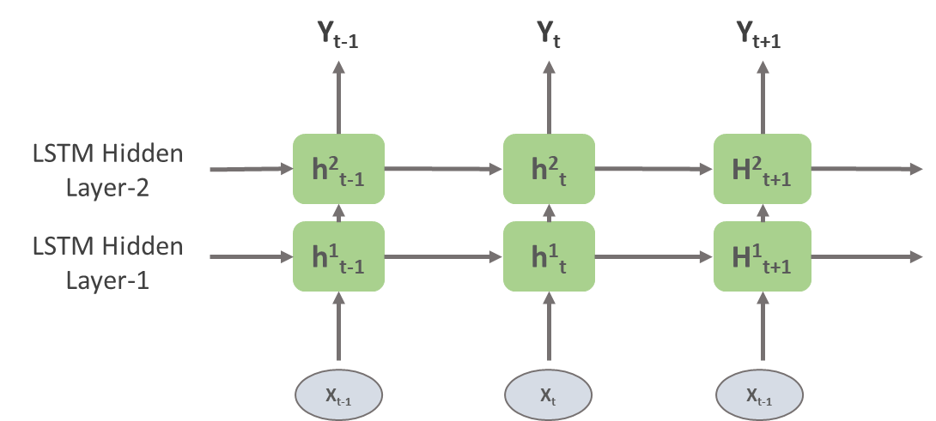
Stacked LSTM
Here we pass the hidden state t through another LSTM layer.
Can stack infinitely but would require skip connections.

Slide 9
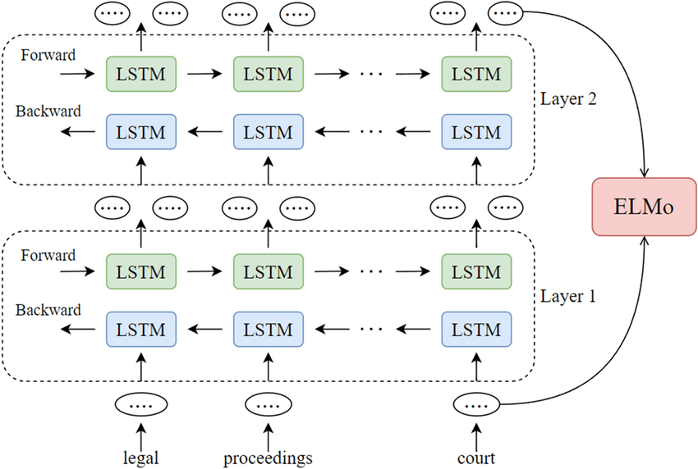
ELMo
ELMo is a combination of Bidirectional and Stacked LSTMs
ELMo yields incredibly good contextualized embeddings.

Slide 10
Seq2Seq Modeling
Tasks such as: Machine Translation and Question Answering
Takes n and outputs m. (different sizes)
Would need two models: encoder and decoder.
Encoder would output a hidden state htE which is the last hidden state output.
This state would be the first input to the decoder h1D.
The same concept can be applied to transformers.

Slide 11
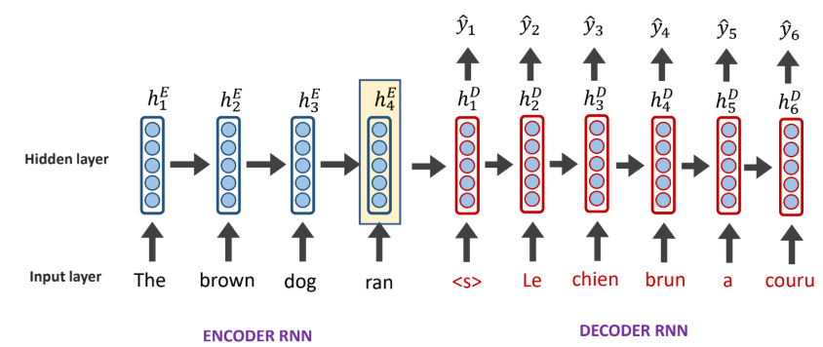
Seq2Seq RNN

Slide 12
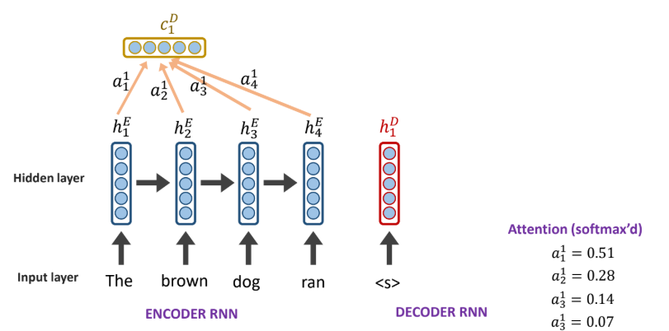
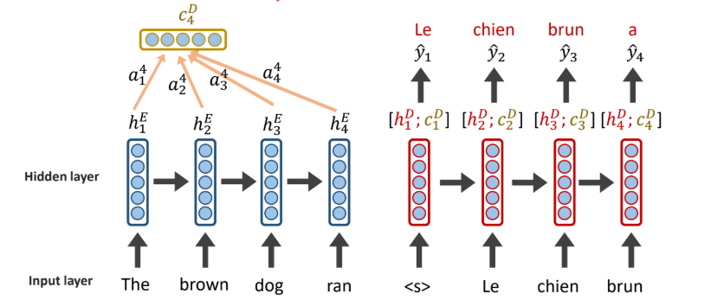
Attention
Determines how much focus should the decoder pay to each hidden state from the encoder.
Can be calculated by multiple ways, even a feed forward layer is sufficient.

Slide 13
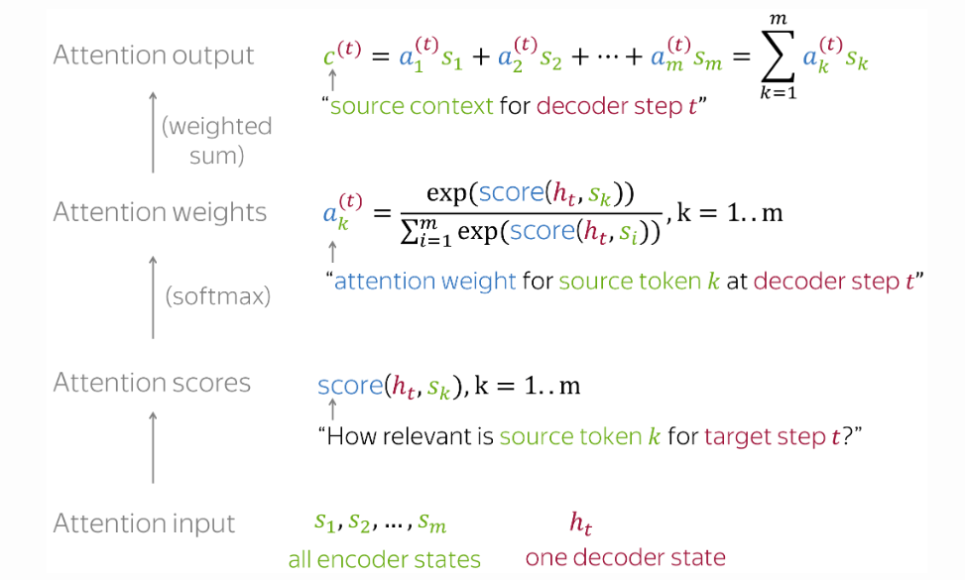
Attention calculation
https://lena-voita.github.io/nlp_course/seq2seq_and_attention.html

